Slide 1
What is TCA’s purpose?
TCA Mission Statement
Image acquired from https://www.i-magazin.com/jetzt-neu-das-eaton-infocenter/

Slide 2
TCA Mission Statement:
The Classical Academy exists to assist parents in their mission to develop exemplary citizens, equipped with analytical thinking skills, virtuous character, and a passion for learning, all built upon a solid foundation of knowledge.

Slide 3
To assist parents…
Who is a child’s first teacher?
Teachers
Parents
Students
Image acquired from https://www.clubmarine.co.nz/internet/clubnz.nsf/docs/MG26-3+CM+Assist

Slide 4
To develop exemplary citizens…
What are the qualities of an exemplary citizen?
“This City is what it is because our citizens are what they are.”
Plato(circa 380 BC)
School
Country
parents
teachers
students
citizens
Image acquired from http://www.debate.org/opinions/is-every-american-citizen-entitled-to-constitutional-rights

Slide 5
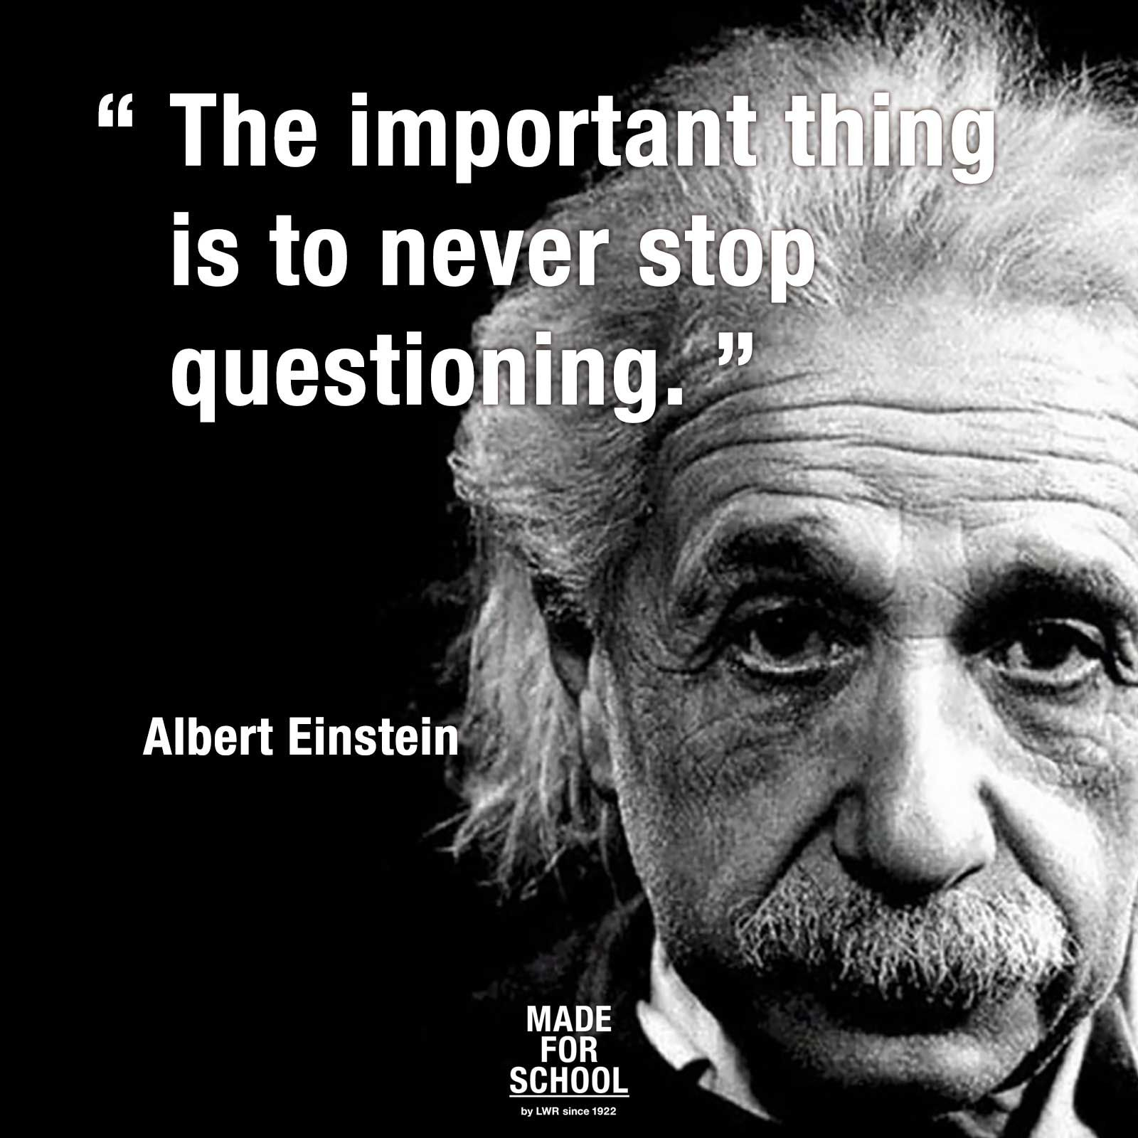
Equipped with analytical thinking skills…
What does it mean to be an analytical thinker?
How does one think analytically?
Image acquired from http://www.brainfacts.org/thinking-sensing-and-behaving/thinking-and-awareness?page=3

Slide 6
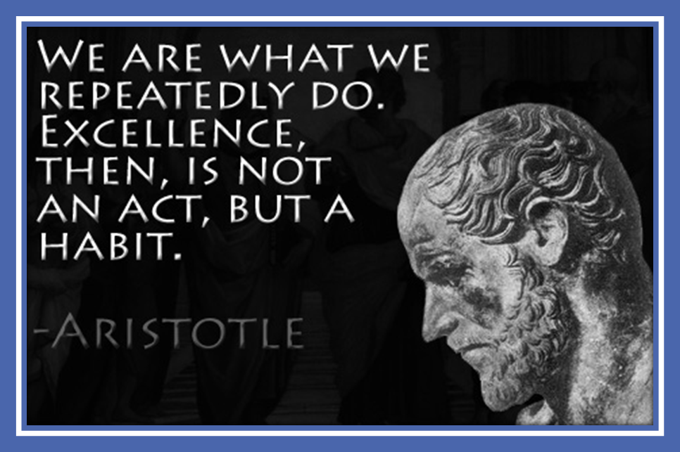
Virtuous character…

Slide 7
Virtuous character…
What is Virtue?
What are some examples of Virtues?
Virtues in Action (VIA)
Wisdom: Creativity – Curiosity – Judgment – Love of Learning – Perspective
Courage: Bravery – Perseverance – Honesty – Zest
Humanity: Love – Kindness – Social Intelligence
Justice: Teamwork – Fairness – Leadership
Temperance: Forgiveness – Humility – Prudence – Self-Regulation
Transcendence: Appreciation of Beauty/Excellence – Gratitude – Hope – Humor – Spirituality

Slide 8
Passion for learning…
Image acquired from https://www.opencolleges.edu.au/informed/features/how-to-ignite-passion-in-your-students-8-ways-educators-can-foster-passion-based-learning/

Slide 9
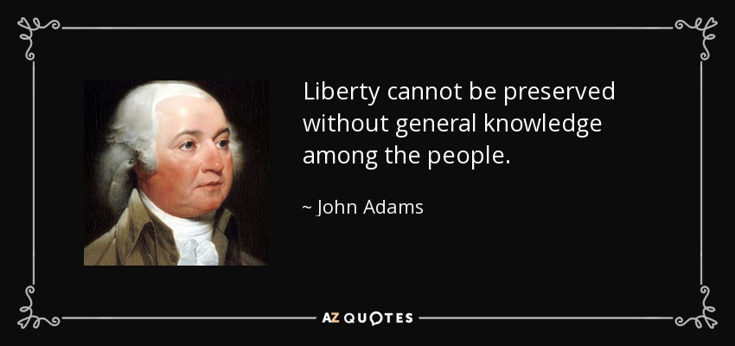
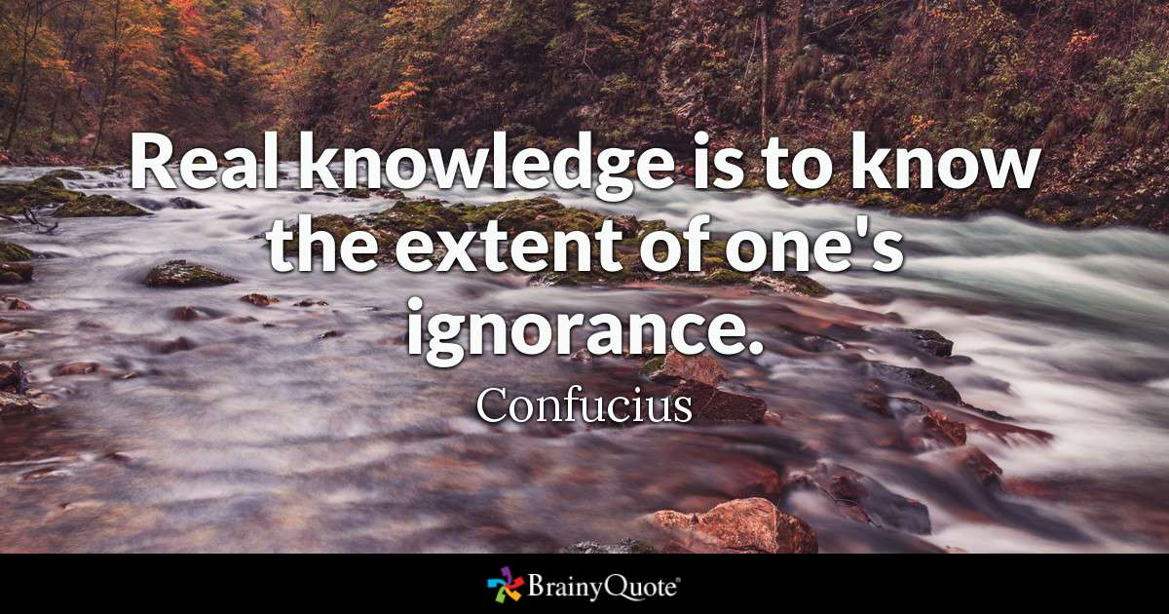
Built upon a solid foundation of knowledge.
What is knowledge?
Why is knowledge the foundation?
How does knowledge connect to virtue, analytical thinking, and passionate learning?
“To know thyself is the beginning of wisdom.” ― Socrates
“Knowledge is power.” ― Francis Bacon

Slide 10
Analytical Thinking (Skills)
Virtuous Character
Passion for Learning
Knowledge

Slide 11
TCA Mission Statement:
The Classical Academy exists to assist parents in their mission to develop exemplary citizens, equipped with analytical thinking skills, virtuous character, and a passion for learning, all built upon a solid foundation of knowledge.

